Slide 1
What does it mean?

Slide 2
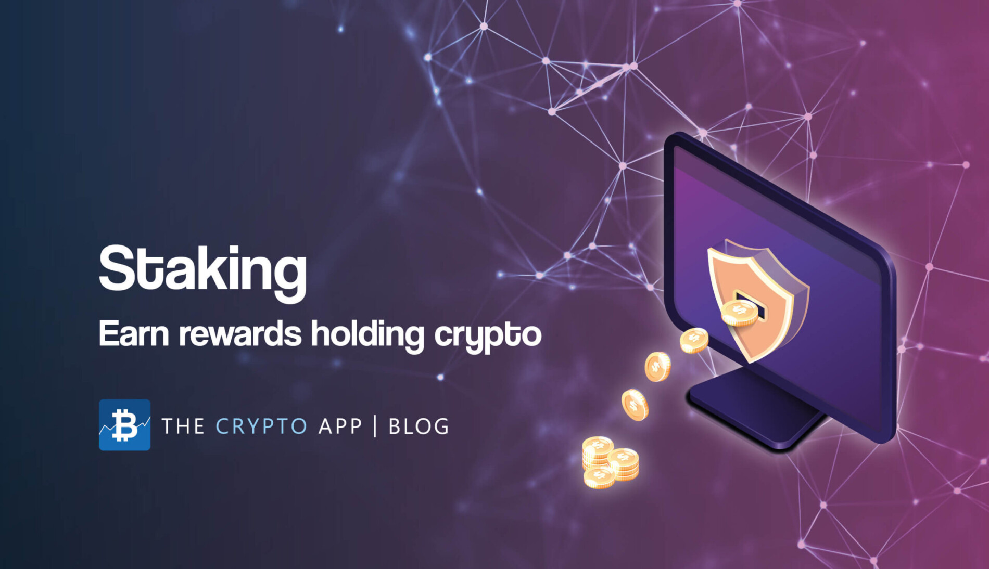

Slide 3
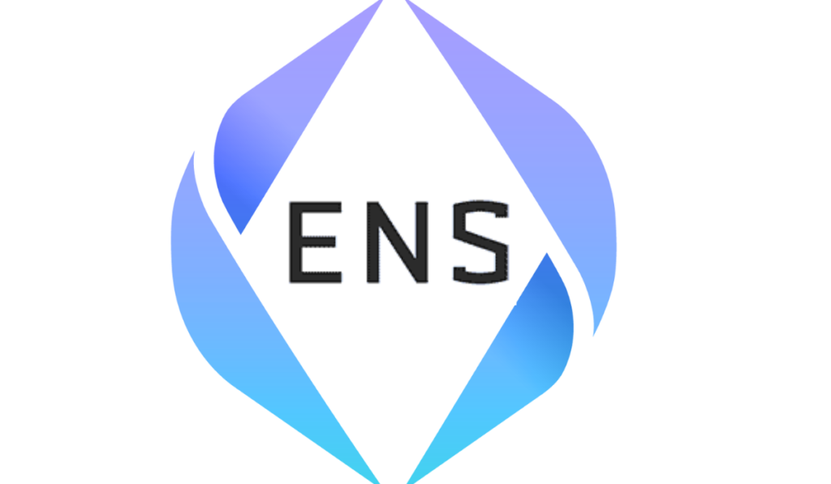

Slide 4
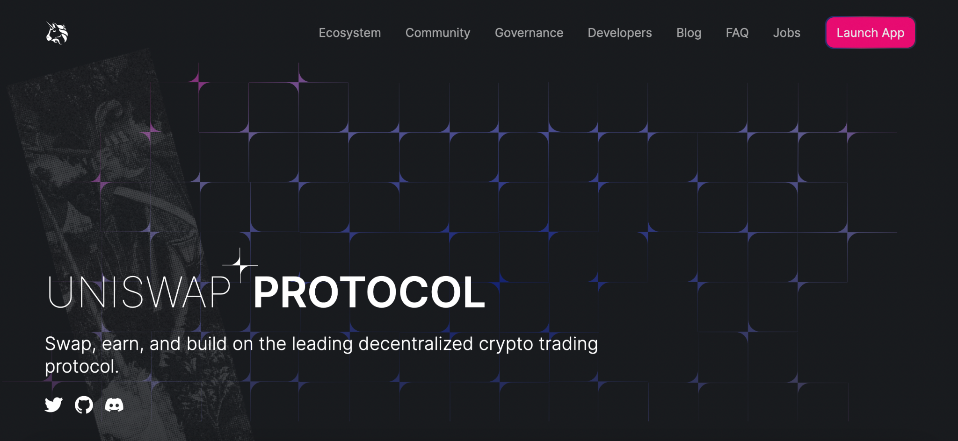

Slide 5
DeFi

Slide 6
Automated
Market
Maker

Slide 7
Liquid Pools

Slide 8
Who understand all of these terms?

Slide 9
Who would save us from money legos?

Slide 10
Who would solve money legos for us?

Slide 11
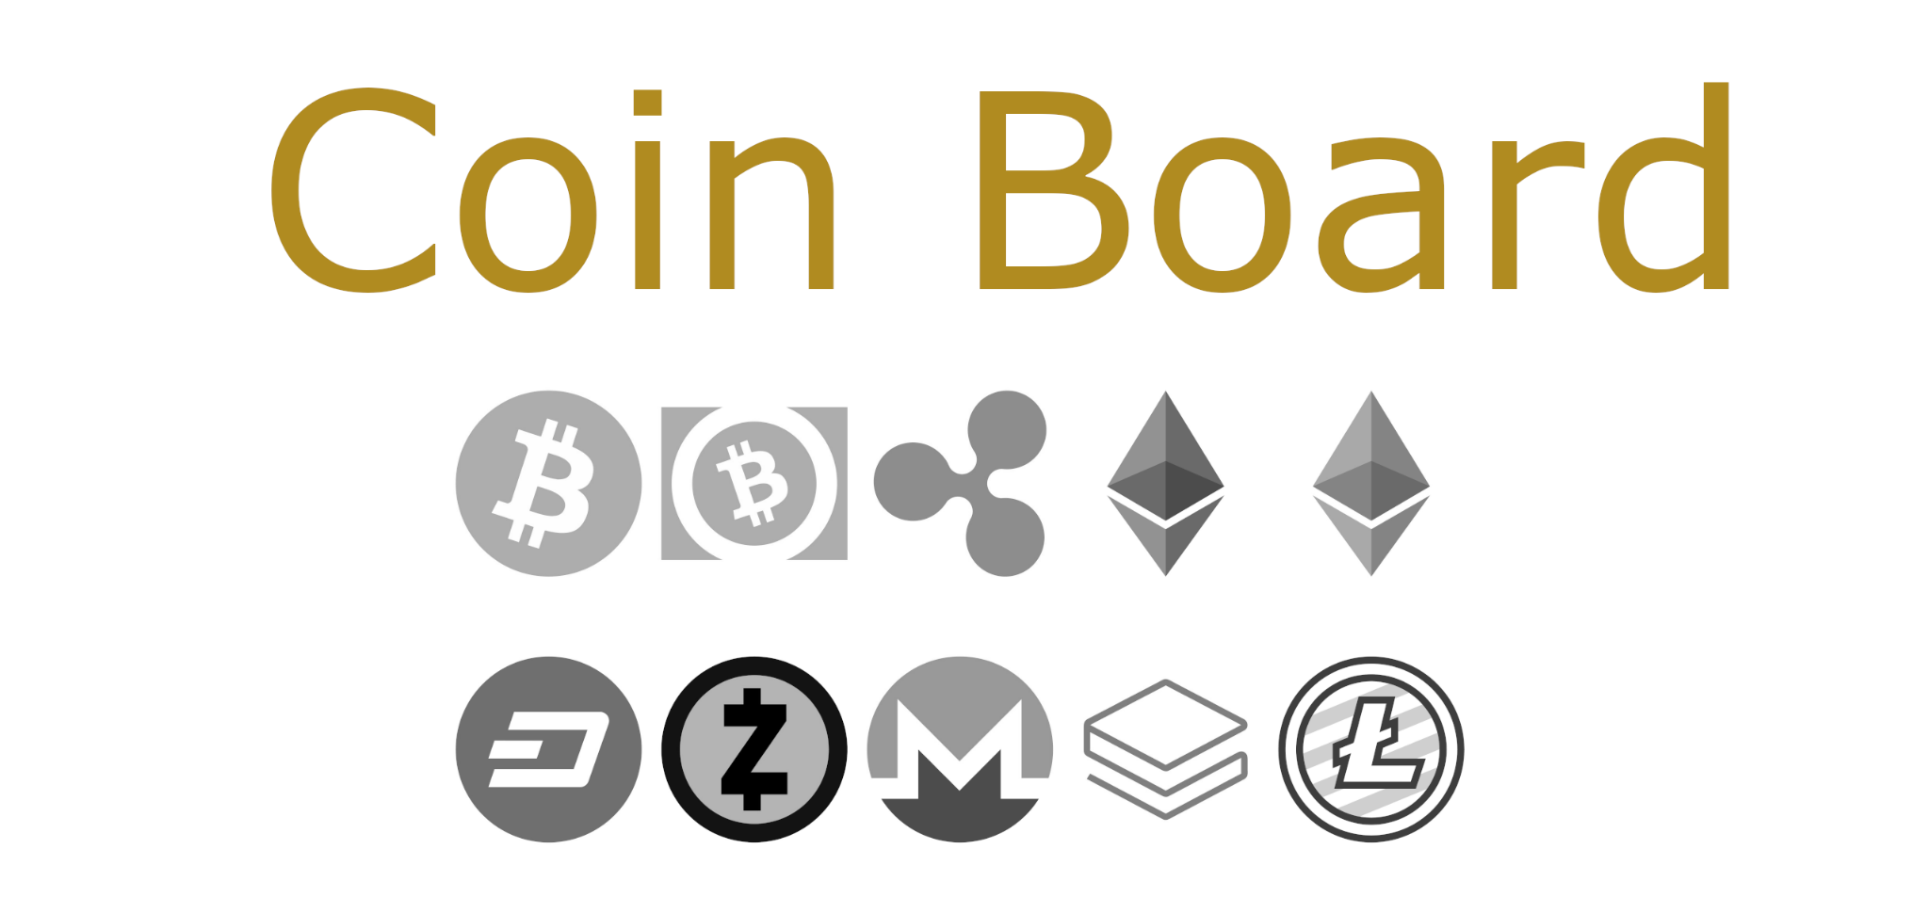

Slide 12
All your money legos solved
in one place

Slide 13






Slide 14
Bank-like dashboard for all your crypto assets

Slide 15
Created for people - not only for geeks

Slide 16
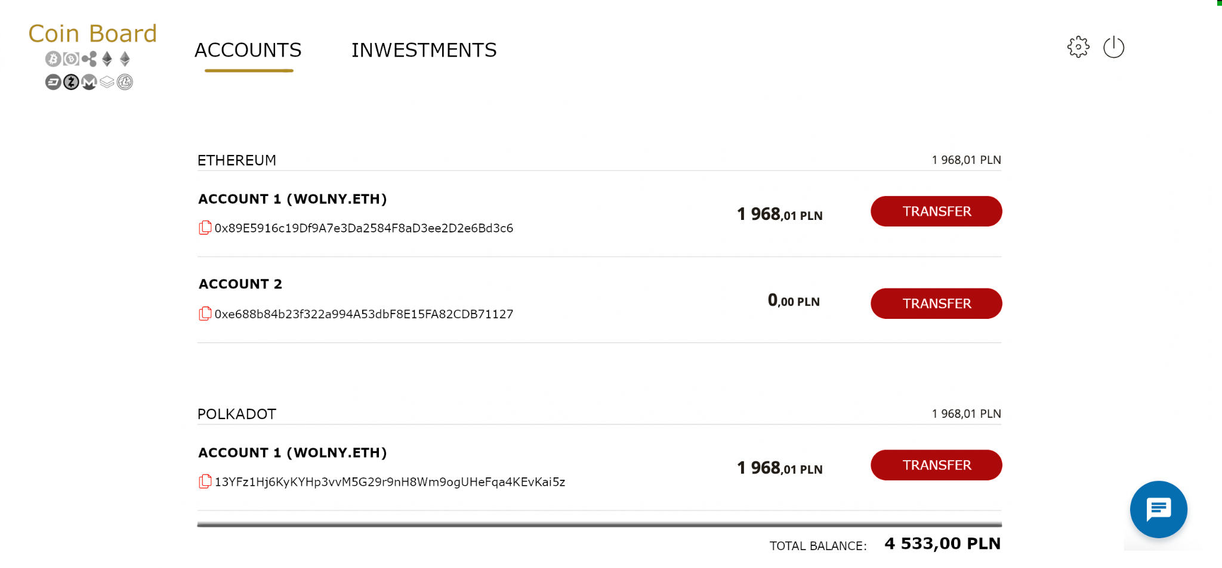

Slide 17
It’s simple like your bank account

